Slide 1
TLM Electrometer Meeting #10
2/13/13

Slide 2
Topics
Progress on digital/analog electrometer designs
Dave
Dan
Other progress
TLM detector spare parts
MARS calculations
Electrometer subsystems design, integration, & packaging
TLM Prototype Testing
Schedule drivers
Schedule
Resources
Future work

Slide 3
Electrometer design progress
See links for:
Dave - http://www-muon.fnal.gov/Personnel/Leveling/References%5CDDC112Electrometer.pptx
Dan - http://www-muon.fnal.gov/Personnel/Leveling/References%5CUltraHighInputImpedanceElectrometerDescription.docx

Slide 4
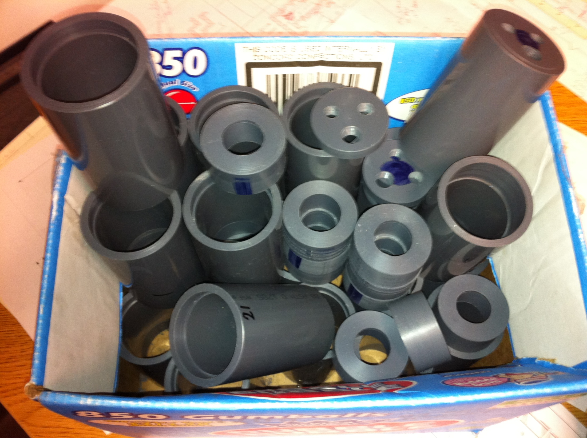

Slide 5
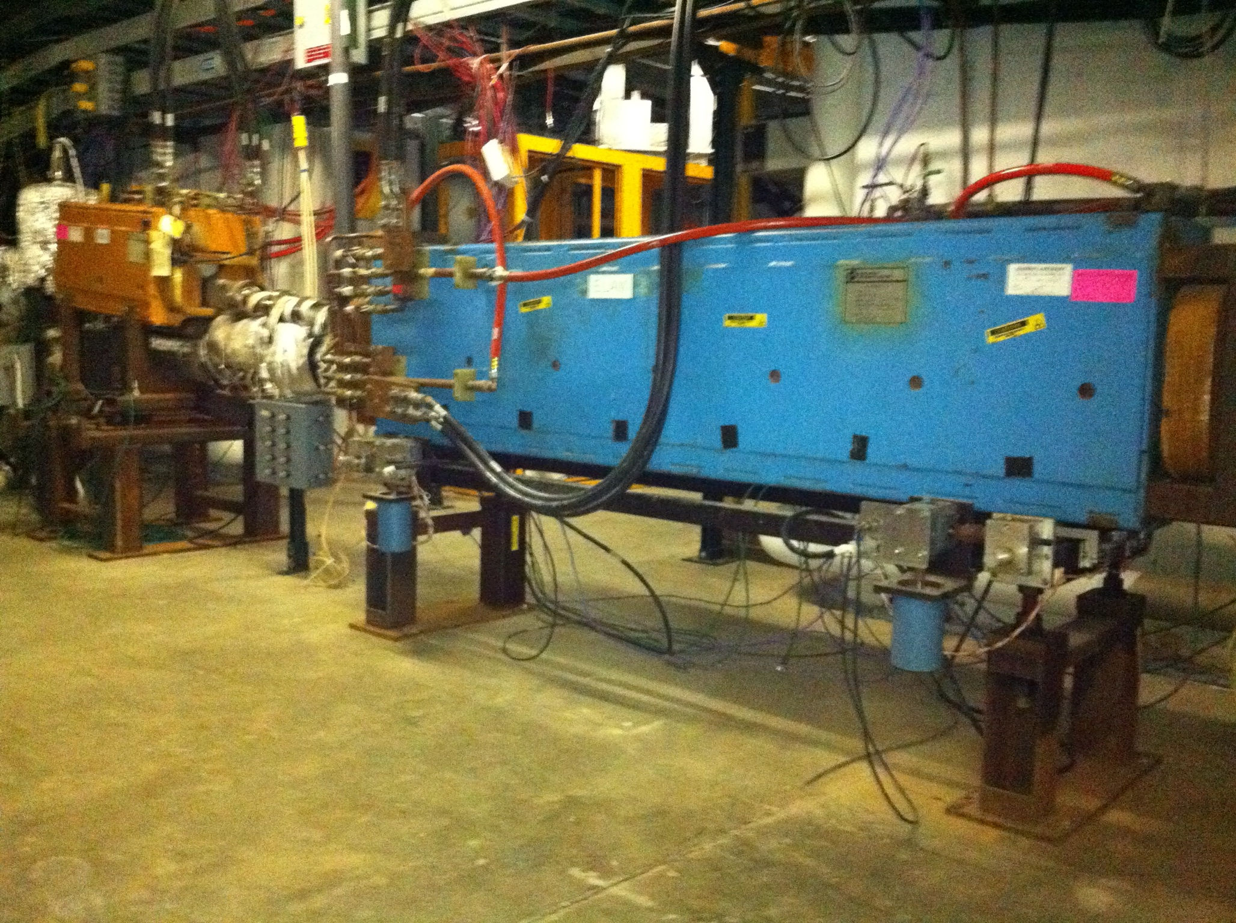

Slide 6
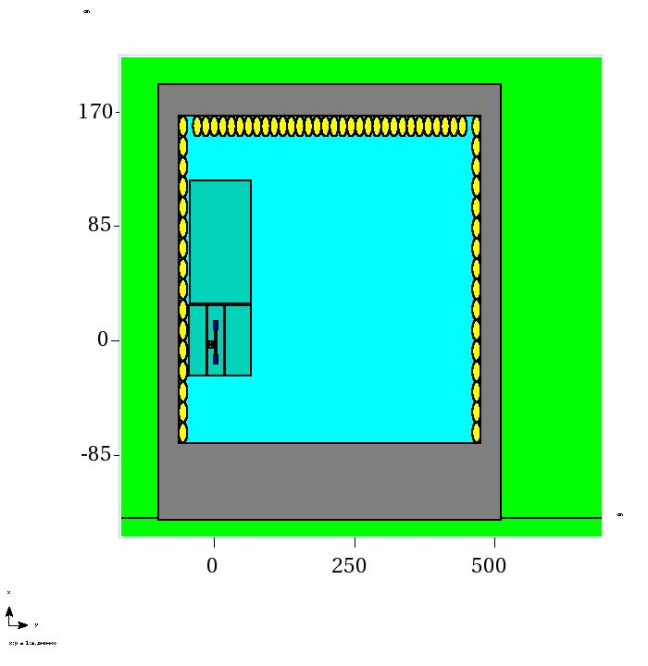
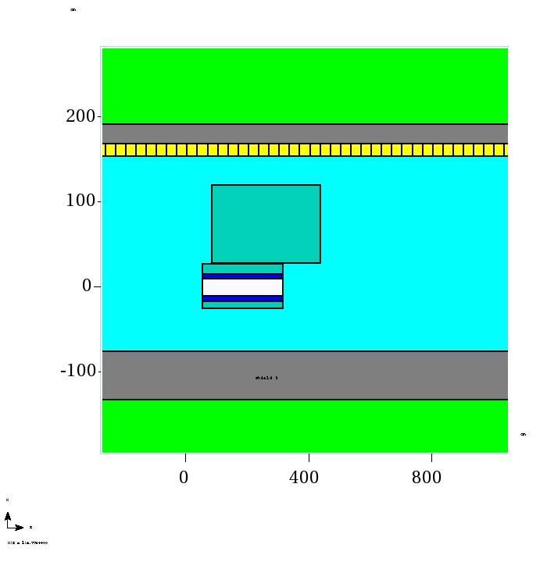
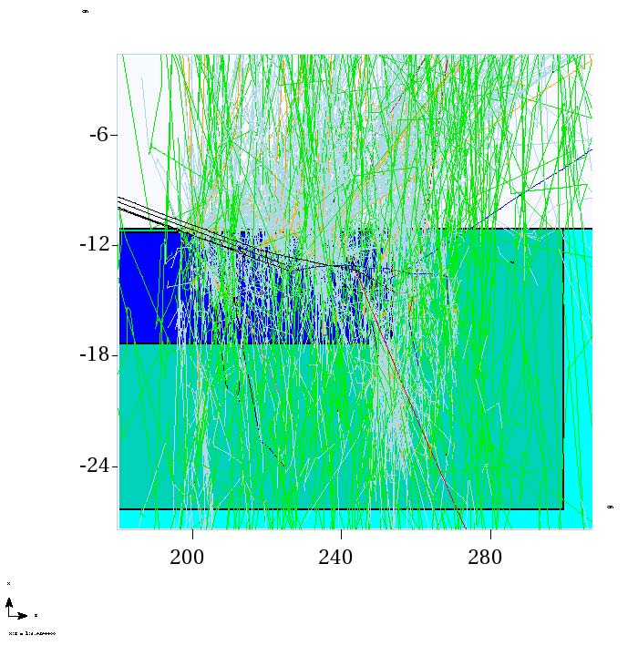
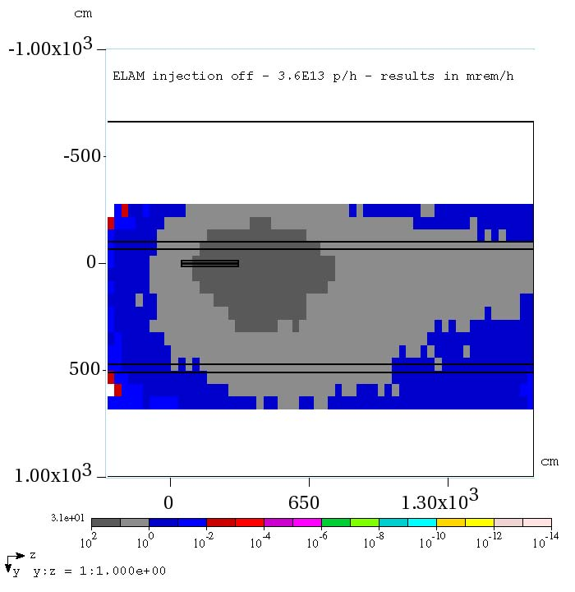
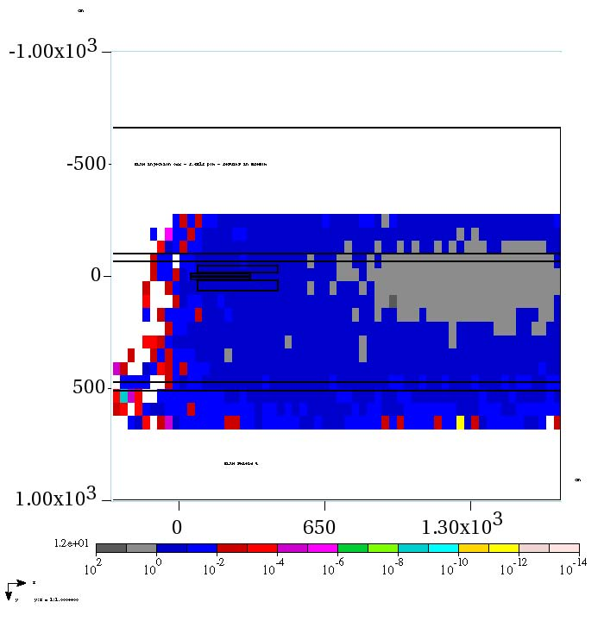

Slide 9
Electrometer subsystems design, integration, & packaging
Concept partially defined
http://www-muon.fnal.gov/Personnel/Leveling/Meetings%5C11-27-12%20TLM%20electrometer%20design%20meeting%20minutes.docx
Need action on this
Project team
Lead engineer, engineer, technician, drafter
Need real people assigned
Tasks
Block diagram
fpga, cpld, up logic design
Board layout
Board stuffing
Bench Testing
Engineering drawings
Field testing (May/June 2013)
Documentation, including test procedure

Slide 10
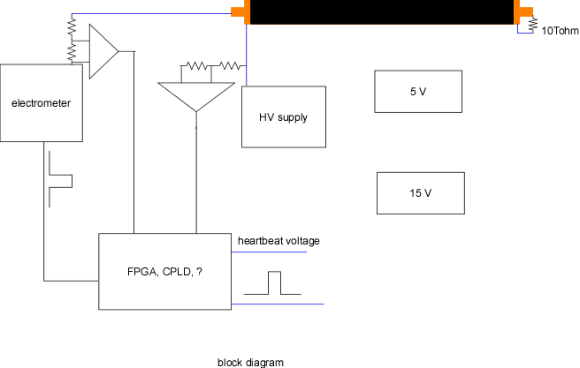
Need a block diagram to communicate the design

Slide 11
Prototype Testing
3 Locations, 3 prototypes
Pbar for continuing measurements
First test three detectors in series
Booster high power testing
MI high power testing
This testing is dual purpose
Test electrometer
Test detector & develop further understanding of response

Slide 12
Schedule drivers
Continue TLM detector testing May/June 2013
Soon as beam is available
TLM Electrometer Approval for use February 2014
Driver for TLM has been mu2e
Plan is to have CD2 review in late summer/early fall 2013
Work on the mu2e final design will be in progress in 2014
mu2e wants to have an approved electrometer design in about 12 months
At some point, a technology decision has to be made to for the mu2e final design
TLMs or
chipmunks

Slide 13
Schedule
Electrometer module development and construction – completed end of April 2013
Prototype and detector testing - May 2013 through September 2013
Documentation submitted to AD ES&H - October 2013
AD ES&H Review and Approval – December 2013
ES&H Section Approval - February 2014
Future work – Final design & construction - TBD

Slide 14
Resources
Lead engineer, Engineer, Project Mangler (Dave, someone, Tony)
Subsystem definitions
FPGA logic
HV supply
Block diagram
TLM detector interface voltage divider
Board designer?
Board production?
Board stuffing?
Module construction?
Drafting?
Documentation – Dave, Tony
Test procedure – Tony, AD Interlocks Group
$$$ - Nathan, Paul – we’ll need a budget code to buy hardware and services

Slide 15
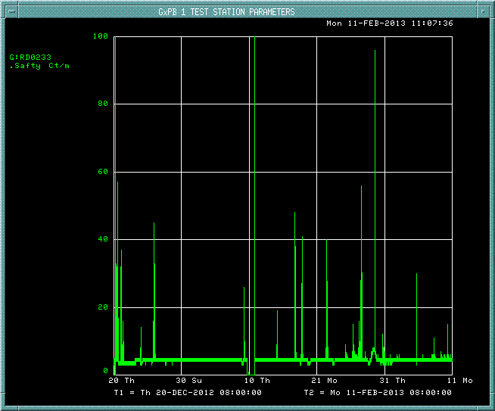

Slide 16
Post meeting notes . . .
John Anderson/Chuck Worel have assigned Glen Federwitz to make block diagram of TLM system. Glen will also do EPLD design work if that technology is chosen for the electrometer support board
Rick Divelbiss has been identified as the contact for drafting and board layout support. Rick has been notified that a request for support will be forthcoming
John Anderson and Nathan Eddy have identified that technician support is available within their departments to stuff boards, etc.
John Anderson has identified that the interlocks group can help with development of electrometer test procedures
Dan Schoo will continue with development and assembly of a prototype analog electrometer
The instrumentation department will assign an FPGA designer if that technology is chosen for the electrometer support board
Adam Olson provided feedback and questions following the 2/13 meeting and has received AD comments.
The issue of budget code for hardware and services to support the TLM electrometer design continues to be unresolved

